Slide 1
Amherst Candy Factory
Presented By:
Mujahidul Islam (2019-2-60-072)
Raisur Rahman (2019-1-60-180)

Slide 2
Problem Description:
Amherst candy factory is preparing up for Halloween and has implemented an
assembly line to ramp up Halloween candy production. The assembly line will be
implemented using a bounded buffer producer and consumers. The factory contains
two types of worker threads: producers and consumers. Each producer thread
produces a certain type of candy, while each consumer creates boxes of assorted
candies using ones produced by producers. After producing each candy, the
producer deposits into the bounded buffer. If the buffer is full, it must wait until
one slot becomes available

Slide 3
Solving the problem:
Producer function:
void *producer()
{
empty--;
pthread_mutex_lock(&mutex);
buffer[in]=item;
in = (in+1)%buffer_size;
pthread_mutex_unlock(&mutex);
full++;
i++;
pthread_exit(NULL);
}
In the function the programme decrease the empty value which we initialize as buffer size. Then we lock the programme so that the consumer thread can not work while producer is running. After inserting the item programme will unlock and increase the full value.

Slide 4
Consumer function:
void *consumer()
{
full--;
pthread_mutex_lock(&mutex);
buffer[out]=-1;
out = (out+1)%buffer_size;
pthread_mutex_unlock(&mutex);
empty++;
j++;
pthread_exit(NULL);
}
In the consumer first we decrease the full value and then we lock the programme to consume the data form buffer then we increase the empty value.

Slide 5
To take input what chocolate to produce:
int candy()
{
printf("\n1. Toffee\n2. Chewing Gum\n3.
Lollipop\n4. Candy Bar\n5. Jelly
Candy\n\n");
int c;
scanf("%d",&c);
printf("\n");
if(c==1)
return 1;
if(c==2)
return 2;
if(c==3)
return 3;
if(c==4)
return 4;
if(c==5)
return 5;
}
To print the chocolate name in main function:
void printcandy(int c)
{
if(c==1)
printf("Toffee ");
if(c==2)
printf("Chewing Gum ");
if(c==3)
printf("Lollipop ");
if(c==4)
printf("Candy Bar ");
if(c==5)
printf("Jelly Candy");
}
It passes the candy name in the main function
In the function user choose which candy to produce. And the input goes to the printcandy function as a parameter

Slide 6
Main Function:
We take buffer size as input. And initialize empty and box size as buffer size.
scanf("%d",&buffer_size);
empty=buffer_size;
box_capacity = buffer_size;
2. We create buffersized producer and consumer thread. And initialize the mutex.
pthread_t prod[buffer_size],cons[buffer_size];
3. User choose option to produce or consume or exit.
printf("\n1. Produce Candy \n2. Consume Candy \n3. Exit\n\n");
scanf("%d",&n);

Slide 7
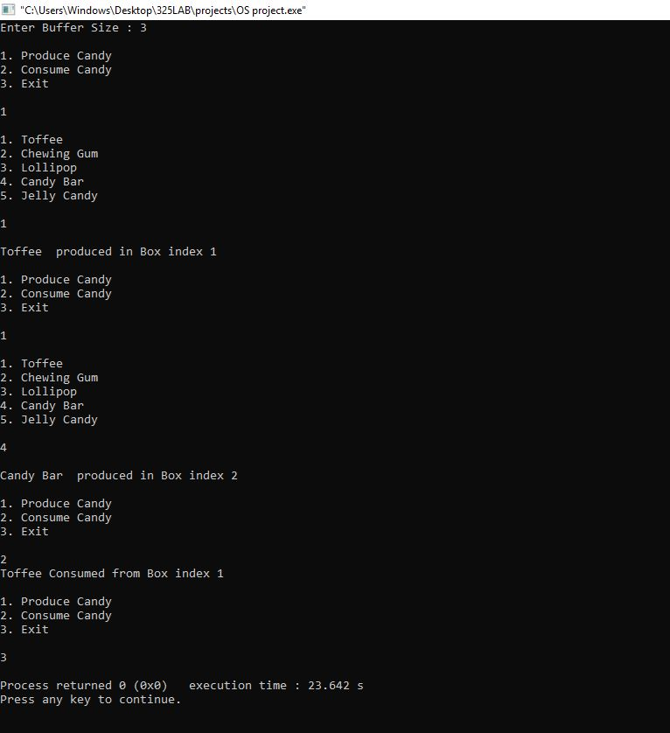
Output:

Slide 8
THANK YOU

